Slide 1
CSC 222: Computer Organization & Assembly Language
3 – Register & Memory

Slide 2
Outline
The Components of Microcomputer System
The CPU
Registers
Memory
Types: RAM, ROM, Cache
Memory Organization & Segmentation
System Bus
Data, Address & Control

Slide 3
References
Chapter 1, Ytha Yu and Charles Marut, “Assembly Language Programming and Organization of IBM PC”
Chapter 3, William Stallings, “Computer Organization & Architecture”
Chapter 2, Subrata Ghoshal, “Computer Organization & Architecture”

Slide 4
The CPU

Slide 5
CPU
Brain of Computer; controls all operations
Uses Memory Circuits to store information
Uses I/O Circuits to communicate with I/O Devices
Executes programs stored in memory
System programs
Application programs
Instruction Set: Instructions performed by CPU
Two main components:
Execution Unit (EU)
Bus Interface Unit (BIU)

Slide 6
Execution Unit (EU)
Purpose: Execute instructions
Contains ALU (Arithmetic & Logic Unit)
To perform arithmetic (+, -, x,/) and logic (AND, OR, NOT) operations.
The data for the operations are stored in circuits called Registers.
A register is like a memory location except that it is referred by a name not a number (address).
EU uses registers for:
Storing data.
Holding operands for ALU
To reflect result of a computation – FLAG register
Notes:
Register details covered in later slides

Slide 7
Bus Interface Unit (BIU)
Facilitates communication between the EU and the memory or I/O circuits.
Responsible for transmitting address, data and control signals on the buses.

Slide 8
Internal Bus
The EU and BIU are connected by an internal bus and they work together.
While EU is executing, the BIU fetches up to six bytes of the next instruction and places them in the instruction queue.
Instruction Pre-fetch
Purpose: Speed up the processor
If the EU needs to communicate with memory or the peripherals, the BIU suspends instruction pre-fetch and performs the needed operations.

Slide 9
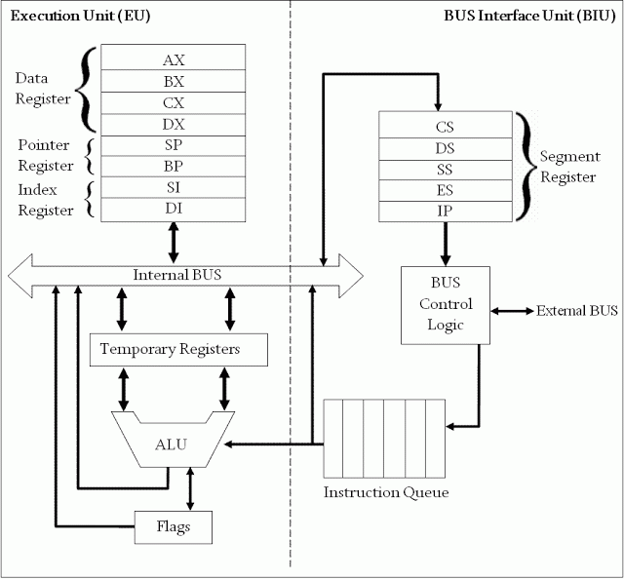
Intel 8086 Microprocessor Organization

Slide 10
Registers

Slide 11
Registers
Registers are high-speed storage locations inside the microprocessor.
Designed to be accessed at much higher speed than conventional memory.
Registers are classified according to the functions they perform.
General Types of Registers:
Data Registers: To hold data for an operation.
Address Registers: To hold the address of an instruction or data.
Status/Flag Register: keeps the current status of the processor or result of an arithmetic operation.

Slide 12
8086 Internal registers 16 bits (2 bytes each)
AX, BX, CX and DX are two
bytes wide and each byte can
be accessed separately
These registers are used as
memory pointers.
6 status; 3 control ; 7 unused
Segment registers are used
as base address for a segment

Slide 13
General Purpose/Data Registers
Following four registers are available to the programmer for general data manipulation:
AX (Accumulator): Used in arithmetic, logic and data transfer instructions. Also required in multiplication, division and input/output operations.
BX (Base): It can hold a memory address that points to a variable.
CX (Counter): Act as a counter for repeating or looping instructions. These instructions automatically repeat and decrement CX and quit when equals to 0.
DX (Data): It has a special role in multiply and divide operations. Also used in input/output operations.

Slide 14
Segment Registers
Store addresses of instruction and data in memory.
These values are used by the processor to access memory locations.
CS (Code): Defines the starting address of the section of memory holding code.
DS (Data): Defines the section of memory that holds most of the data used by programs.
ES (Extra): This is an additional data segment that is used by some of the string instructions.
SS (Stack): It defines the area of the memory used for stack

Slide 15
Pointers and Index Registers
These can be accessed only as 16 bit registers.
IP - instruction pointer: Always points to next instruction to be executed. IP register always works together with CS segment register and it points to currently executing instruction.
SI - source index register: Can be used for pointer addressing of data. Offset address relative to DS
DI - destination index register: Can be used for pointer addressing of data . Offset address relative to ES
SI and DI used in string movement instructions.
SP and BP are used to access data inside the stack segment
BP - base pointer: Primarily used to access parameters passed via the stack. Offset address relative to SS
SP – stack pointer: Always points to top item on the stack. Offset address relative to SS

Slide 16
80386 Extended Registers
The 80386/80486 processor contain 32-bit registers which greatly improve the efficiency of program that take advantage of them.
EAX, EBX, ECX, EDX,
EFLAGS
EIP
EBP, ESP, ESI, EDI.

Slide 17
Memory

Slide 18
Bits, Bytes and Double words
Each 1 or 0 is called a bit.
Group of 4 bits = Nibble
Group of 8 bits = Byte
Group of 16 bits = Word
Group of 32 bits = Double words

Slide 19
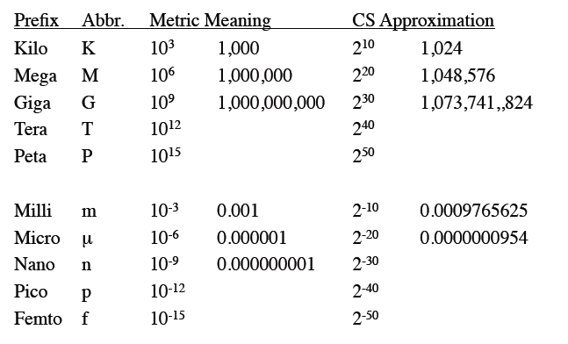
Common Prefixes

Slide 20
Memory
Information processed by the computer is stored in its memory.
Program
Data
Not all accumulated information is needed by the CPU at the same time
Therefore, it is more economical to use low-cost storage devices to serve as a backup for storing the information that is not currently used by CPU
Memory Operations:
Read (Fetch contents of a location)
Write (Store data at a location)

Slide 21
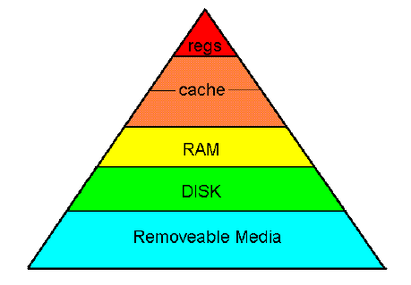
Memory Hierarchy

Slide 22
Contd..
The memory unit that directly communicate with CPU is called the main memory
Devices that provide backup storage are called auxiliary memory
The main memory occupies a central position by being able to communicate directly with the CPU and with auxiliary memory devices through an I/O processor
A special very-high-speed memory called cache is used to increase the speed of processing by making current programs and data available to the CPU at a rapid rate

Slide 23
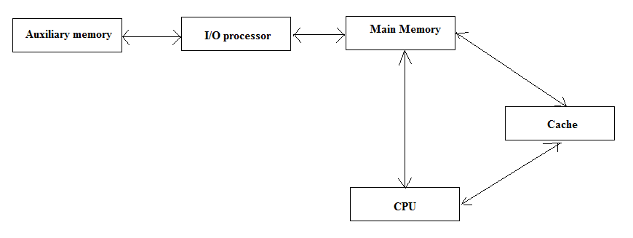
Contd..

Slide 24
Main Memory
Most of the main memory in a general purpose computer is made up of RAM integrated circuits chips, but a portion of the memory may be constructed with ROM chips
Memory Circuits:
RAM
Program Data and Instructions
Read and Write
ROM
Used for storing an initial program called bootstrap loader, which is required to start the computer software operating when power is turned off.
Only Read

Slide 25
Cache
A special very-high-speed memory called cache is used to increase the speed of processing by making current programs and data available to the CPU at a rapid rate.
To reduce memory access time thus program execution time.

Slide 26
Memory Organization
Memory is organized into a collection of bytes.
Each byte is identified by a number – Address
Number of bits in an address depends on the processor
Example:- Intel 8086: 20-bit address, Intel 80286: 24-bit address
Data stored in a memory byte – Contents

Slide 27
Contd..
Number of bits used in the address determines the number of bytes that can be accessed by the processor.
Example: If processor uses 20-bit address, it can access 2²⁰ = 1048576 bytes = 1 MB of memory
Question: If processor uses 24-bit address, how many bytes of memory can be accessed?

Slide 28
Memory Segments
A memory segment is a block of 2¹⁶ (or 64 K) consecutive memory bytes.
Each segment has a number.
Within a segment, memory location is specified by an offset. This is the number of bytes from the beginning of the segment.

Slide 30
Segment : Offset Address
Logical Address = Segment : Offset
16-bit segment, 16-bit offset
Physical Address = Segment * 10h + Offset
20-bit address
Example:
Logical Address = A4FB:4872
Physical Address = A4FB0h + 4872h = 0A9822h

Slide 31
Exercise
A memory location has a physical address 4A37Bh. Compute:
a. The offset address if the segment number is 40FFh.
b. The segment number if the offset address is 123Bh.

Slide 32
Program Segments
A typical machine language program is loaded into following different memory segments:
Code Segment
Data Segment
Stack Segment
Stack is a data structure used by processor to implement procedure calls.

Slide 33
System Bus

Slide 34
What is a Bus?
A communication pathway connecting two or more devices
Often grouped
A number of channels in one bus
e.g. 32 bit data bus is 32 separate single bit channels
Address Bus
CPU
Memory
I/O
Control Bus
Data Bus

Slide 35
Data Bus
Carries data
Remember that there is no difference between “data” and “instruction” at this level
Width is a key determinant of performance
8, 16, 32, 64 bit

Slide 36
Address bus
Identify the source or destination of data
e.g. CPU needs to read an instruction (data) from a given location in memory
Bus width determines maximum memory capacity of system
e.g. 8080 has 16 bit address bus giving 64k address space

Slide 37
Control Bus
Control and timing information
Memory read/write signal
Interrupt request
Clock signals

Slide 38
Types of Transfer
Memory to Processor
Processor to Memory
I/O to Processor
Processor to I/O
I/O to and from Memory

Slide 39
Interconnection Structure
Memory
N words of equal length, each word having a unique address
Unit of Transfer (read/Write): Word
Operation: Read/Write indicated by Control Signal
Location of operation specified by an address
I/O Module
Two operations: read and write
May control other external devices
Port: interface between I/O module and device
Able to send interrupt signal to CPU

Slide 40
Contd..
CPU
Reads in instruction and data
Writes out data
Uses control signal to control all operations
Receives interrupt signal

Slide 41
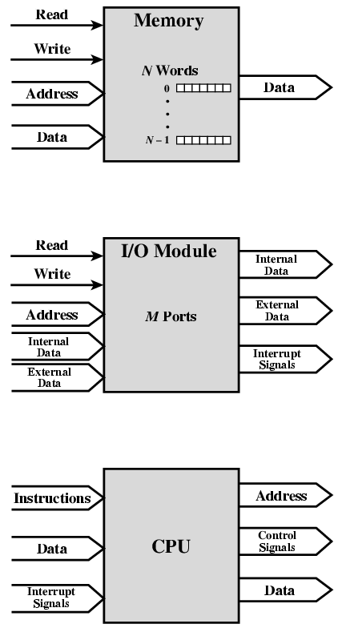
Address
Data Read
Data Write
Interrupt Signals

